Slide 1
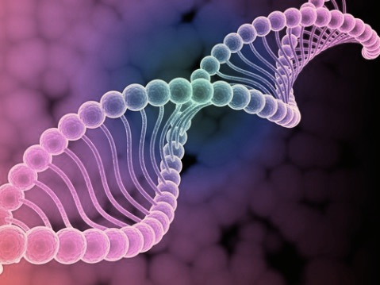
Basic Introduction
to Molecular Biology

Slide 2
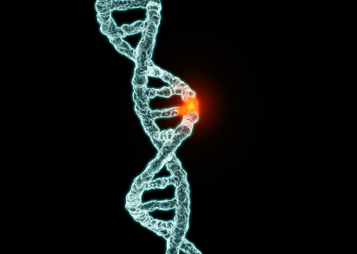
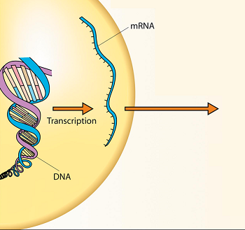
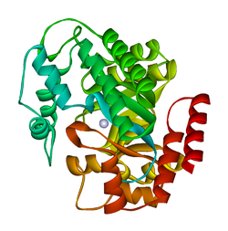
Stem Cells: Genetic Disorders
Defective Gene
Sequence
Defective Protein
Notes:
In the central dogma of molecular biology, DNA encodes information which is then converted to mRNA, and translated to proteins. A defective gene sequence may lead to a defective protein that can then cause disease in patients. I will show how some mutations in blood forming stem cells lead to disease.
<number>

Slide 3
[VIDEO: CDB]

Slide 4
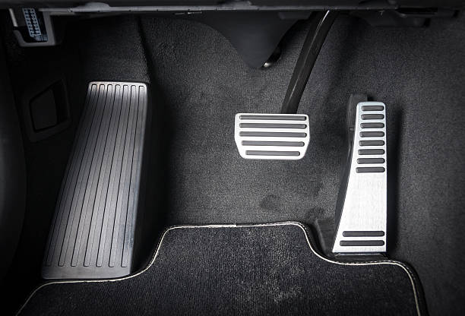
Cancer mutations: Oncogenes
oncogenes are genes that normally help cells grow. When a proto-oncogene mutates (changes) or there are too many copies of it, it becomes a "bad" gene that can become permanently turned on or activated when it is not supposed to be.

Slide 5
Cancer mutations: tumor suppressor genes
Tumor suppressor genes are normal genes that slow down cell division, repair DNA mistakes, or tell cells when to die (a process known as apoptosis or programmed cell death). When tumor suppressor genes don't work properly, cells can grow out of control, which can lead to cancer.

Slide 6
Let’s try it out: Exercise 1

Slide 7
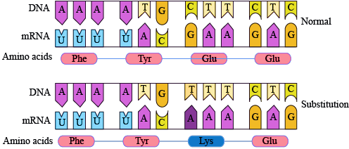
What happens if there is a “bug” in the code?

Slide 8
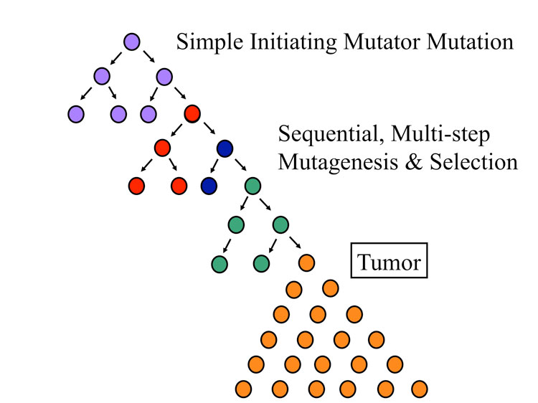
Multistep model of Cancer
Cancer cells are formed by an accumulation of mutations

Slide 9
Sorting Cell Types
What are some criteria that you can use to sort out Citrus fruit vs Tomato?
Notes:
Red tomato, Cherry tomato, Orange cherry tomato, orange, mandarin.
<number>

Slide 10
Sorting Cell Types
What are some criteria that you can use to sort out Citrus fruit vs Tomato?
Notes:
Red tomato, Cherry tomato, Orange cherry tomato, orange, mandarin.
<number>

Slide 11
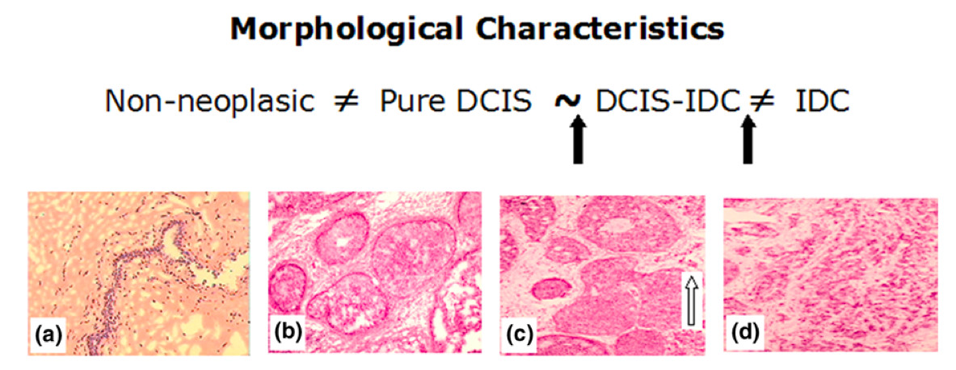
Object | Parameter | Parameter | Parameter | Parameter
Object | Morphology (Shape) | CD34+ (Surface Marker) | Location | Protein Expression
Cell 1
Cell 2
Cell 3

Slide 12
Object | Parameter | Parameter | Parameter | Parameter
Object | Morphology (Shape) | CD34+ (Surface Marker) | Location | Protein Expression
Cell 1
Cell 2
Cell 3

Slide 13
How can we detect cancer?

Slide 14
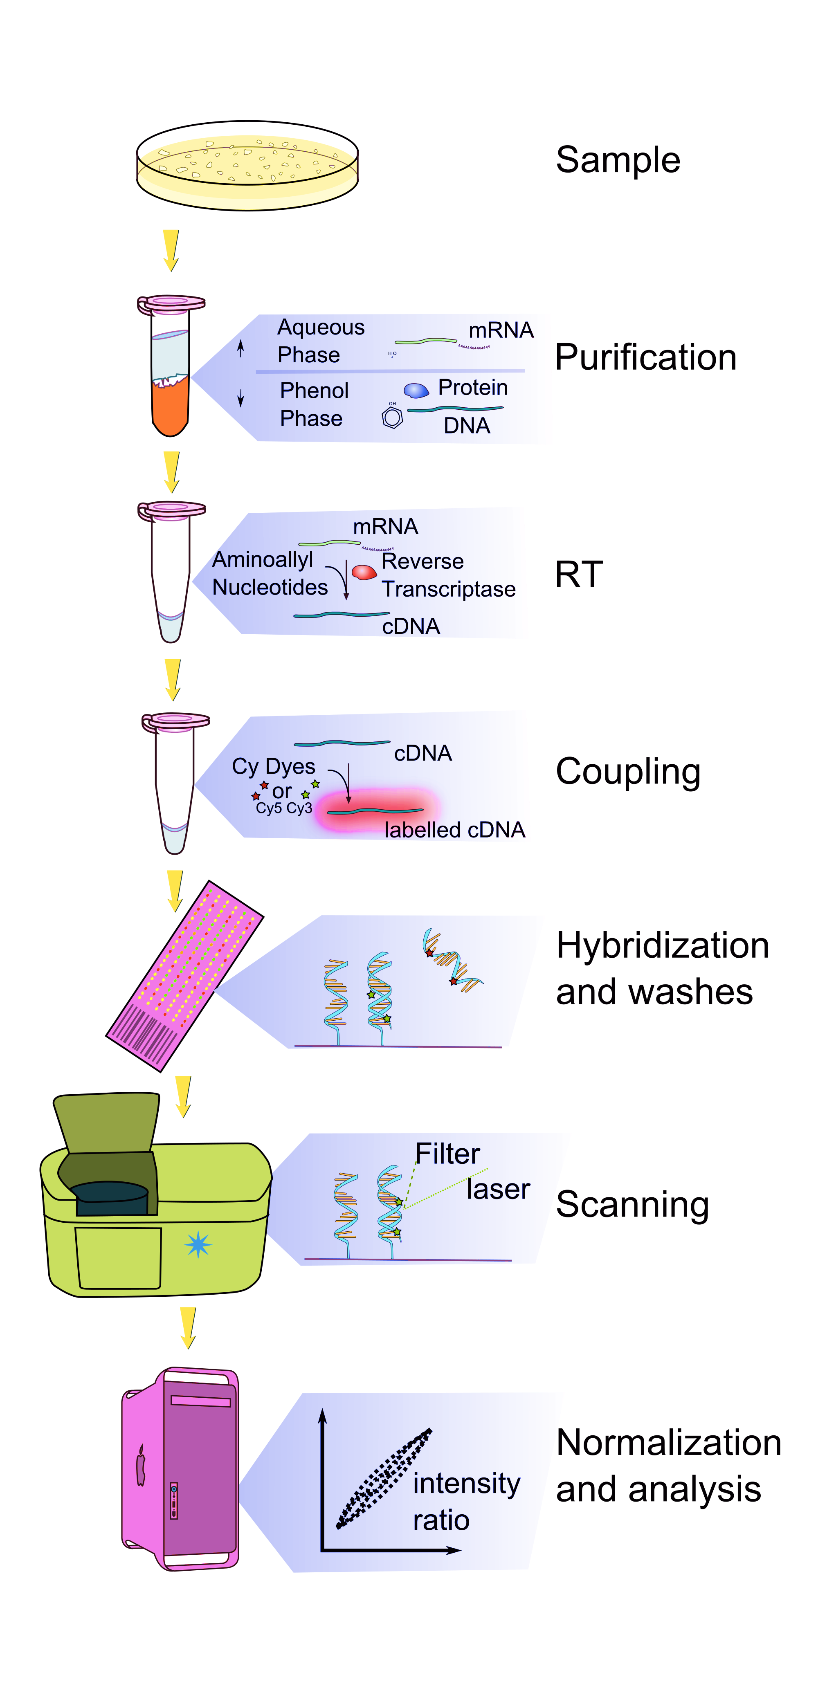
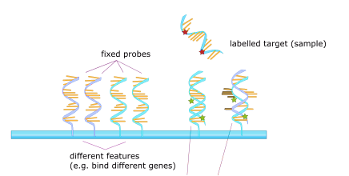
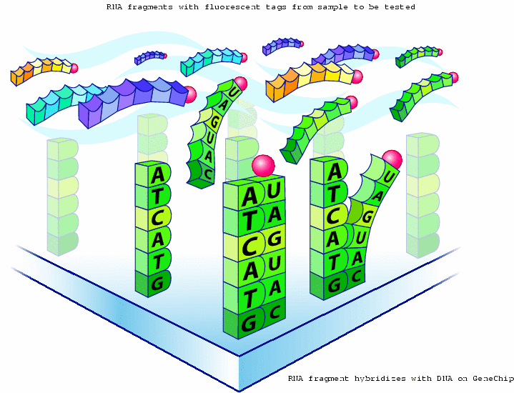
Gene Expression Profiling with Microarrays

Slide 15
Microarrays

Slide 16
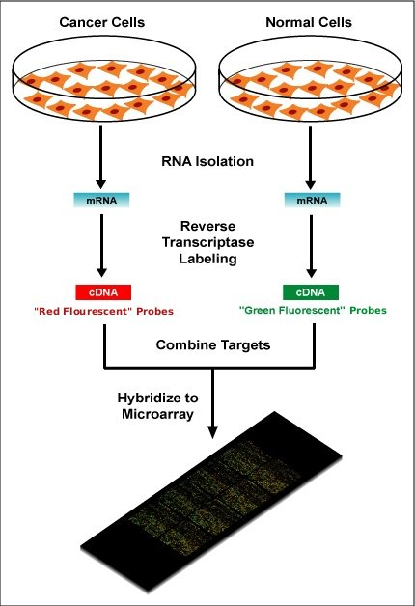
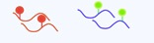
Normal versus Tumor

Slide 17
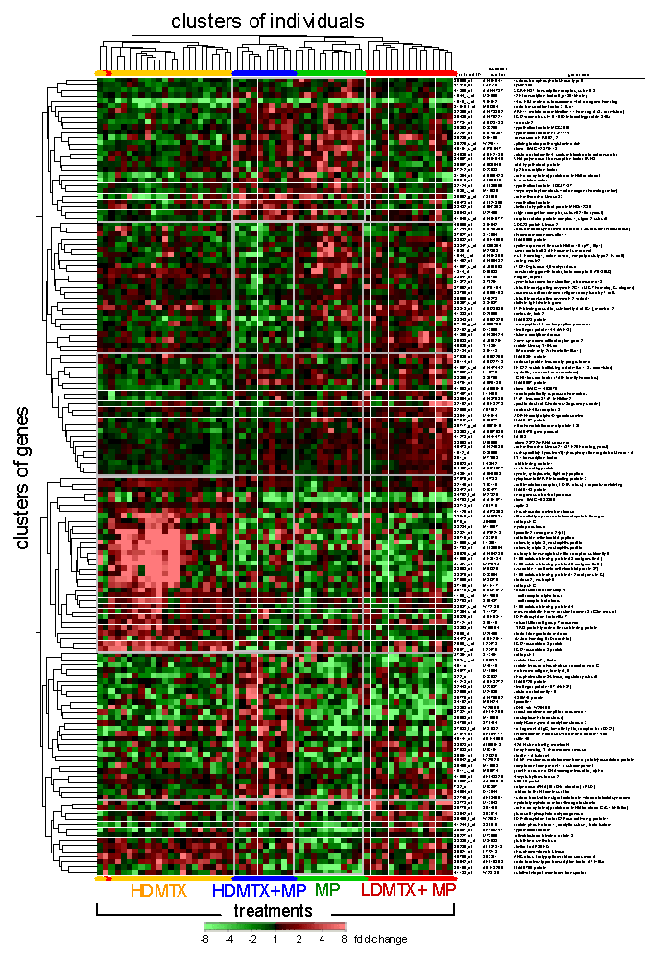
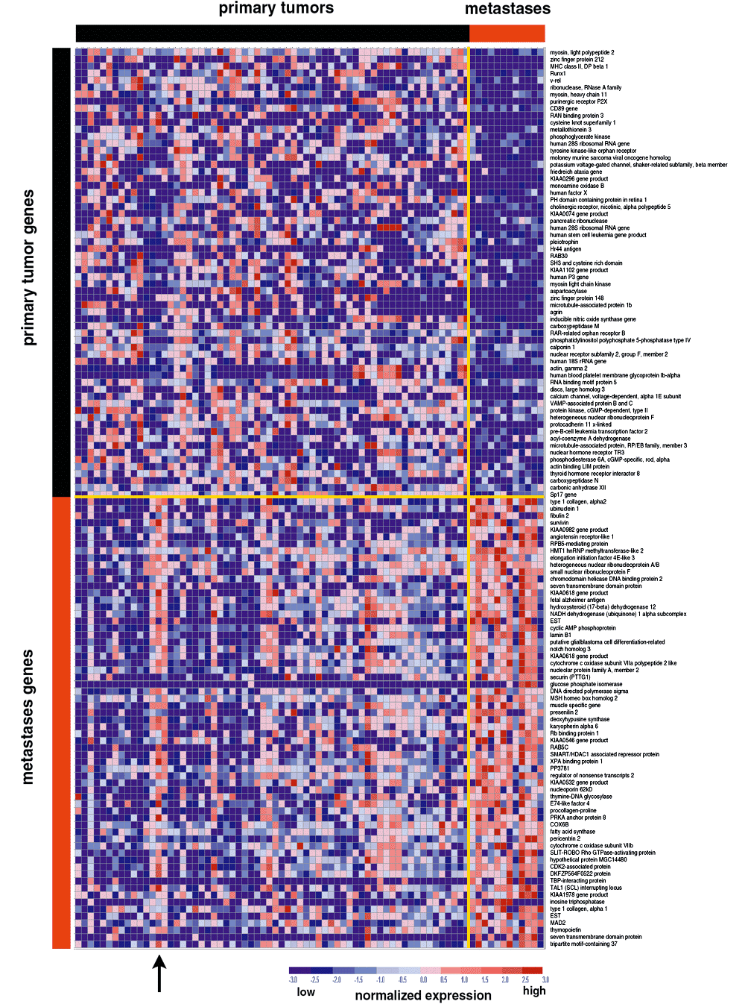
Multiple tumor samples

Slide 18
If we had several examples of normal and tumor cell data, what would we do to determine whether an unknown sample is tumor or normal?

Slide 19
K-Means Clustering
… Or what to do when your
data doesn't have labels

Slide 20
Some example use cases
of Unsupervised Learning
Unsupervised learning is performed when you don't have labels for your data, but you would like to check if there are any patterns.
Group emails or search results
Customer shopping patterns
Regions of images
Clusters of genes

Slide 21
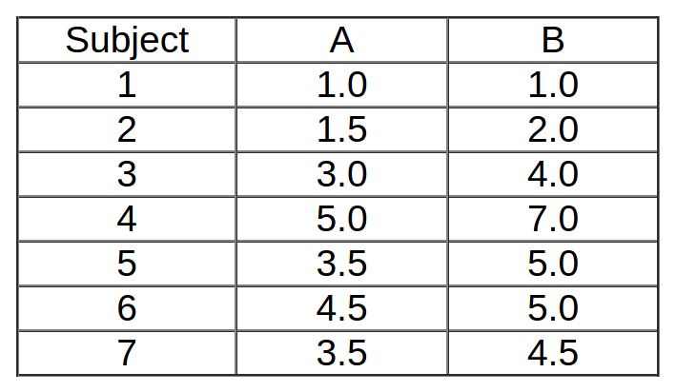
Example: Data

Slide 22
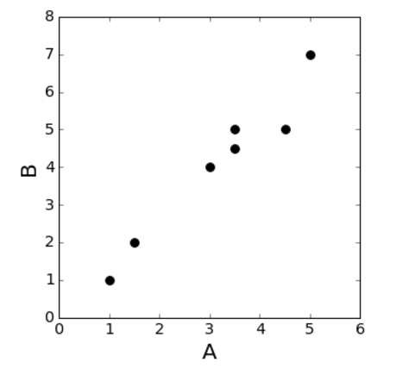
Goal: Split the data into 2 classes
K=2

Slide 23
Step 1: Randomly initialize the cluster centroids
The centroid refers to the “middle point” of the cluster in Euclidean space.
You can pick any point that is in the range of your dataset.
Our random number generator returns the following:

Slide 24
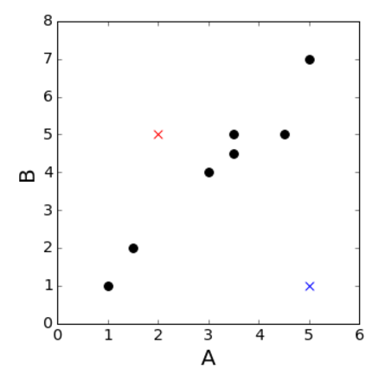
Step 1: Randomly initialize the cluster centroids
 | Red Cluster (0) | Blue Cluster (1)
A | 2 | 5
B | 5 | 1

Slide 25
Step 2: Find the Euclidean Distance of Each Point from Each Cluster
Datapoint | Distance from centroid 0 | Distance from centroid 1 | Closest centroid
1 | 4.12 | 4 | 1
2 | 3.04 | 3.64 | 0
3 | 1.4 | 3.60 | 0
4 | 3.60 | 6.0 | 0
5 | 1.5 | 4.2 | 0
6 | 2.5 | 4.03 | 0
7 | 1.58 | 3.80 | 0

Slide 26
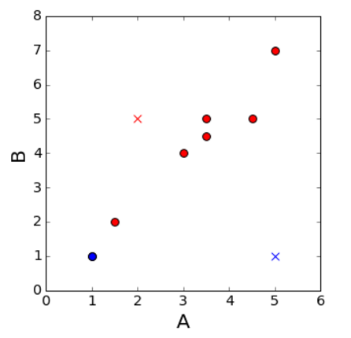
Give labels to your point: points get the label of the closest cluster

Slide 27
Recalculate the centroids:
find the mean A & B for each cluster
Centroid of cluster 0:
A=mean(1.5,3.0,5.0,3.5,4.5,3.5)
A= 3.5
B= mean(2.0,4.0,7.0,5.0,5.0,4.5)
B=4.58
Centroid of cluster 1:
A=mean(1)
A=1
B=mean(1)
B=1

Slide 28
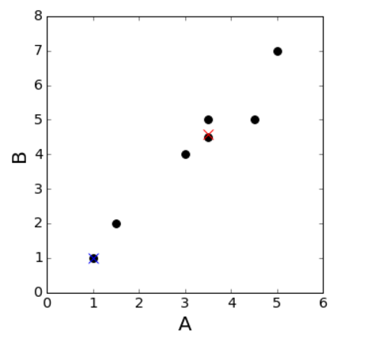
Our new centroids!

Slide 29
Repeat the two steps until your labels don't change anymore
Reassign your labels:
Datapoint | Distance from centroid 0 | Distance from centroid 1 | Closest centroid
1 | 4.36 | 0 | 1
2 | 3.26 | 1.11 | 1
3 | 0.76 | 3.60 | 0
4 | 2.84 | 7.21 | 0
5 | 0.419 | 4.71 | 0
6 | 1.08 | 5.31 | 0
7 | 0.08 | 4.3 | 0

Slide 30
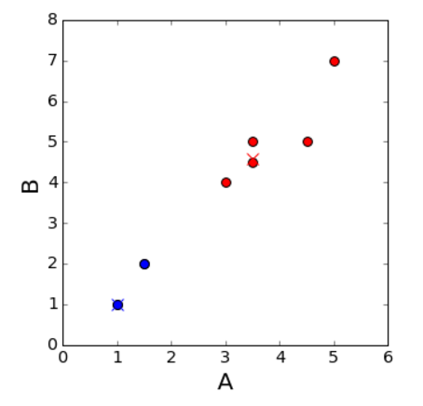

Slide 31
Repeat the two steps until your labels don't change anymore
Recompute your centroids
Centroid of cluster 0:
A=mean(3.0,5.0,3.5,4.5,3.5)
A= 3.89
B= mean(4.0,7.0,5.0,5.0,4.5)
B=5.09
Centroid of cluster 1:
A=mean(1,1.5)
A=1.25
B=mean(1,2)
B=1.5

Slide 32
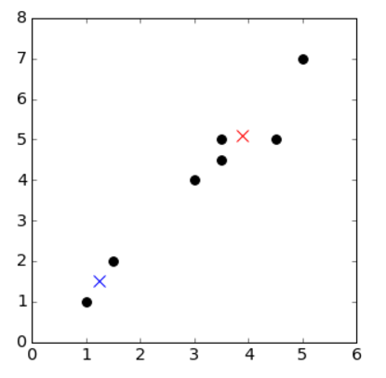

Slide 33
Repeat the two steps until your labels don't change anymore
Reassign your labels:
Datapoint | Distance from centroid 0 | Distance from centroid 1 | Closest centroid
1 | 5.00 | 0.55 | 1
2 | 3.91 | 0.55 | 1
3 | 1.40 | 3.05 | 0
4 | 2.21 | 6.65 | 0
5 | 0.400 | 4.16 | 0
6 | 0.61 | 4.77 | 0
7 | 0.70 | 3.75 | 0

Slide 34
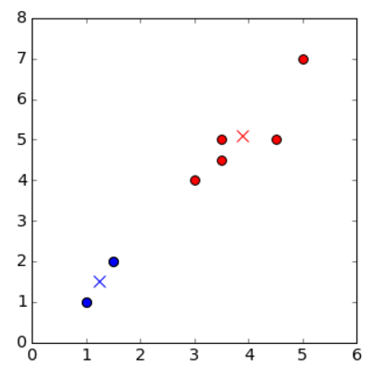
Our labels have not changed since the last iteration, so we're done!

Slide 35
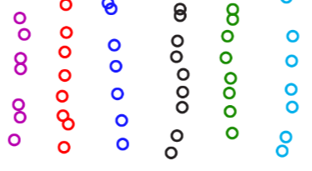
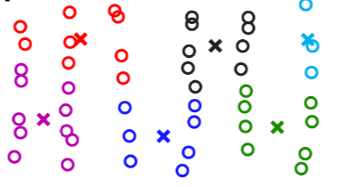
When will K-Means fail?

Slide 36
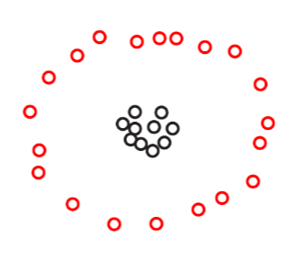
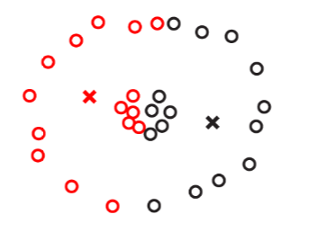
When will K-means fail?

